Slide 1
Trending Epidemiology in South Dakota
Jan 1, 2013 – Dec 31, 2022

Slide 2
Types of Hepatitis C reported to SDDOH - SD, 2013-2022
Total number of cases reported during 2013-2022: 6,260
On average, 626 new cases per year
Chronic: 6,128 (97.9%)
Acute: 127 (2%)
Perinatal: 5 (<.1%)
Notes:
Cases included in this analysis:
Disease status: Confirmed/probable
Investigation status: Completed
SD residents only
Chronic, Acute, and Perinatal Hepatitis C
Data were extracted on Sep 12th, 2023
Hepatitis C Cases: Total 2023:
538. Seems to be lower than previous years. 2022 had just under 700, and 2021 had just under 850.

Slide 3
Hepatitis C Cases by Year – SD, 2013-2022
Notes:
2023 through Nov

Slide 4
Gender distribution of cases – SD, 2013-2022

Slide 5
Racial distribution of cases – SD, 2013-2022
Notes:
Missing race
AI/AN went up from 31% in 9 years previous to 41% in 2023 through November.
White reduced from 40% in 9 years previous to 28.84 in 2023 through November
So we are seeing comparatively more AI/AN cases and fewer white cases in 2023 compared to previous 9 years.
/ethnicity on laboratory reports

Slide 6
Age at diagnosis for hepatitis C Cases – SD, 2013-2022
Mean Age: 42 Years
Range: 0 – 93 Years

Slide 7
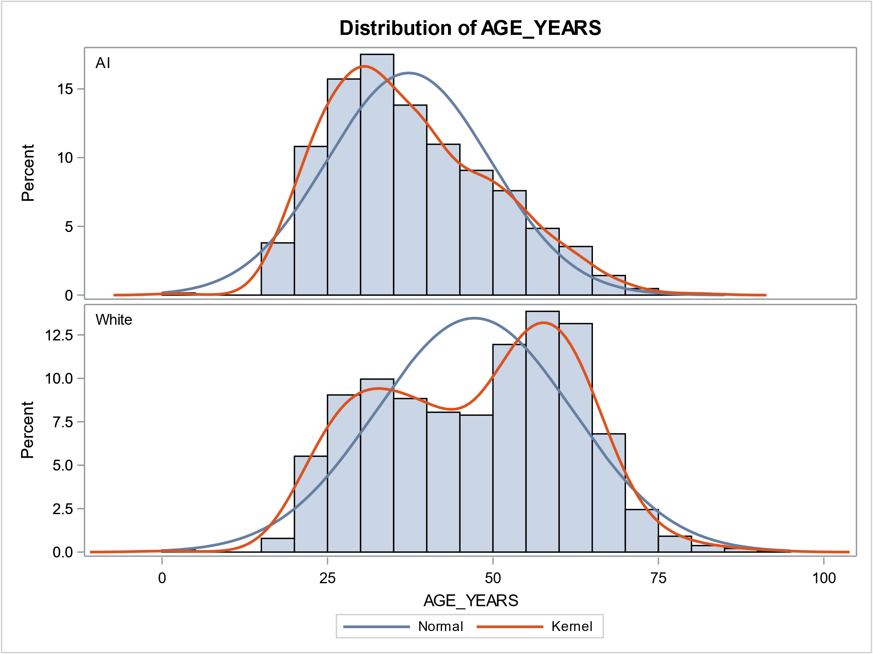
American Indians diagnosed at much younger age – SD, 2013-2022
Average age at diagnosis for American Indians: 37.3 years
Average age at diagnosis for Whites: 47.2 years

Slide 8
Race of Hepatitis C Cases by year – SD, 2013-2022
Number of cases is steadily increased for American Indians while case counts remain stable for Whites
Notes:
Data Includes all cases 2013-2022:
DOC Facility
Count 2013-2022
South Dakota State Penitentiary
287
South Dakota Womens Penitentiary
58
Jameson Annex
2
Mike Durfee State Prison
27
Rapid City Minimum Center
XXXX
Yankton Minimum Center
4
Total Positive Tests
378
% Of Positive Tests From DOC 2013-2022
6.04%

Slide 9
Perinatal Hepatitis C Cases – SD, 2013-2022
Counties with reported cases | Number of cases reported | Percent
Edmunds | 1 | 20%
Meade | 1 | 20%
Moody | 1 | 20%
Pennington | 2 | 40%
Total | 5 | 100%

Slide 10
Top 15 Counties with the highest cumulative number of Hepatitis C Cases – SD, 2013-2022
Top 5 counties with the highest number of cases – 56% of all cases

Slide 11
Top 5 counties with the highest cumulative incidence per 100,000 population – SD, 2013-2022
Notes:
Corson and Todd

Slide 12
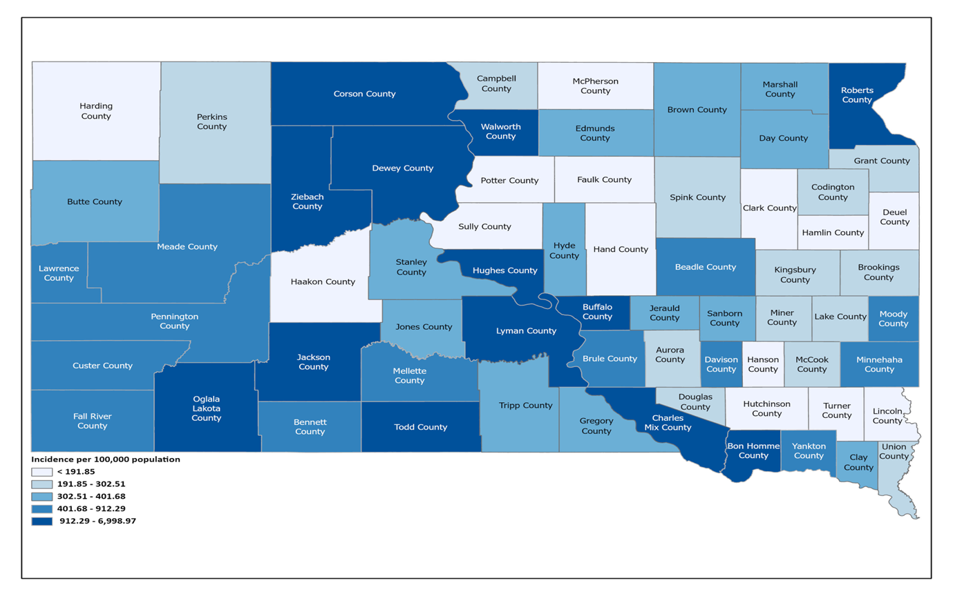
Map of cumulative incidence per 100,000 population – SD, 2013-2022
Notes:
Data 2013 - 2022

Slide 13
Rates per 100,000 of newly reported cases of acute Hepatitis C virus infection by state — United States, 2021

Slide 14
Rates per 100,000 of newly reported cases of chronic Hepatitis C virus infection — United States, 2021
SD ranks 20th

Slide 15
Rates per 100,000 of newly reported cases of chronic Hepatitis C virus infection — Neighboring States, 2021

Slide 16
Rates per 100,000 of newly reported cases of chronic Hepatitis C virus — 5 states with the highest percentage of Native American Population, 2021

Slide 17
Newly reported confirmed cases of acute and chronic hepatitis C by race — United States vs South Dakota, 2021
US rates retrieved from: https://www.cdc.gov/hepatitis/statistics/2021surveillance/hepatitis-c.htm

Slide 18
Hepatitis C cases coinfected with STIs and HIV - SD, 2013-2022
Out of 6,260 hepatitis C cases
498 episodes of coinfection with syphilis
2,003 episodes of coinfection with chlamydia
1,789 episodes of coinfection with Gonorrhea
25 cases coinfected with HIV
Notes:
There is a substantial burden of hepatitis C in South Dakota
77.7 cases per 100,000 population in 2022
Number of chronic hepatitis C cases significantly outnumbers acute hepatitis C case counts
American Indians affected disproportionately
American Indians tend to get infected at an earlier age compared to whites

Slide 19
Comparison of top 5 Hepatitis C counties to Syphilis, and HIV: Cumulative case counts - SD 2013-2022
Notes:
Minnehaha, Pennington, and Corson counties experience Hep C at higher rates than other STIs
Data Includes all cases 2013-2022:
DOC Facility
Count 2013-2022
South Dakota State Penitentiary
287
South Dakota Womens Penitentiary
58
Jameson Annex
2
Mike Durfee State Prison
27
Rapid City Minimum Center
XXXX
Yankton Minimum Center
4
Total Positive Tests
378
% Of Positive Tests From DOC 2013-2022
6.04%

Slide 20
Congenital and Early Syphilis
Notes:
So speaking of SD being #1 -

Slide 21
Cumulative cases of congenital syphilis over time in South Dakota: 2022 & Jan-Oct, 2023

Slide 22
Congenital syphilis: Mother’s county of residence by percent of all cases: Jan-Oct, 2023

Slide 23
Congenital syphilis: Mother’s Race: Jan-Oct, 2023

Slide 24
Congenital syphilis: Did mother access prenatal care?: Jan-Oct, 2023
Notes:
Prenatal care is defined by CDC surveillance definition as any healthcare encounter

Slide 25
Early syphilis: Monthly and cumulative counts: Jan-Oct, 2023

Slide 26
Early syphilis: Top 5 counties of residence: Jan- Oct, 2023

Slide 27
Early syphilis by race: Jan-Oct, 2023

Slide 28
Early syphilis by age categories: Jan-Oct, 2023

Slide 29
Other Reportable Disease Information

Slide 30
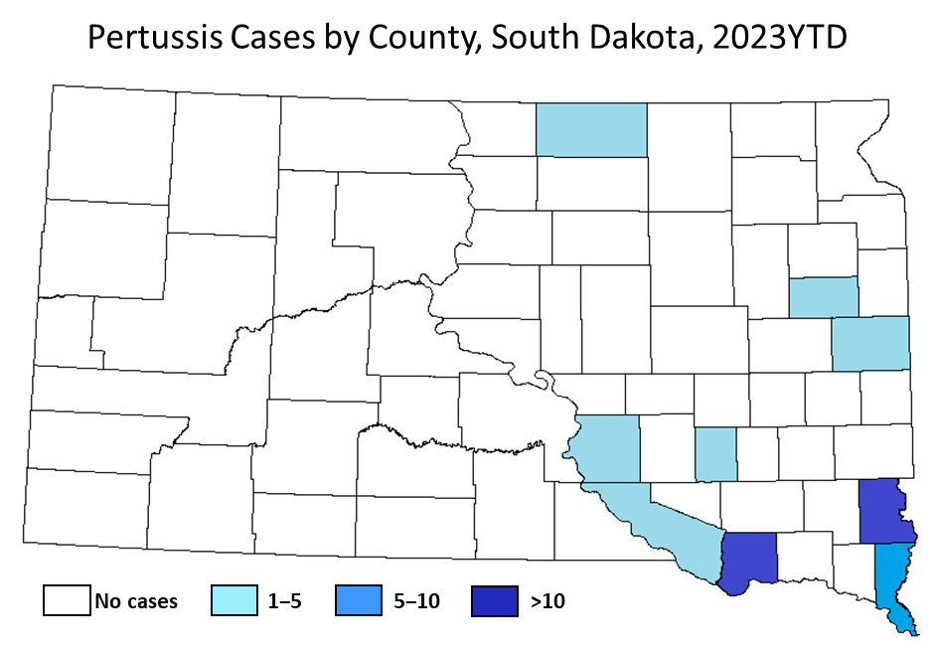
Pertussis
Infectious agent: Bordetella pertussis
Symptoms: Cough, initially intermittent then paroxysmal
Testing: PCR (NP swab/aspirate)
Isolation is important to reduce transmission
>80% of susceptible household contacts are infected
2023 Updates – Pertussis is Rising!
38 pertussis cases reported YTD
2 hospitalized (5% of cases)
25 unvaccinated (66%)
12 cases in infants ≤1 year of age (32%)
Several outbreaks identified in Hutterite colonies (88%)

Slide 31
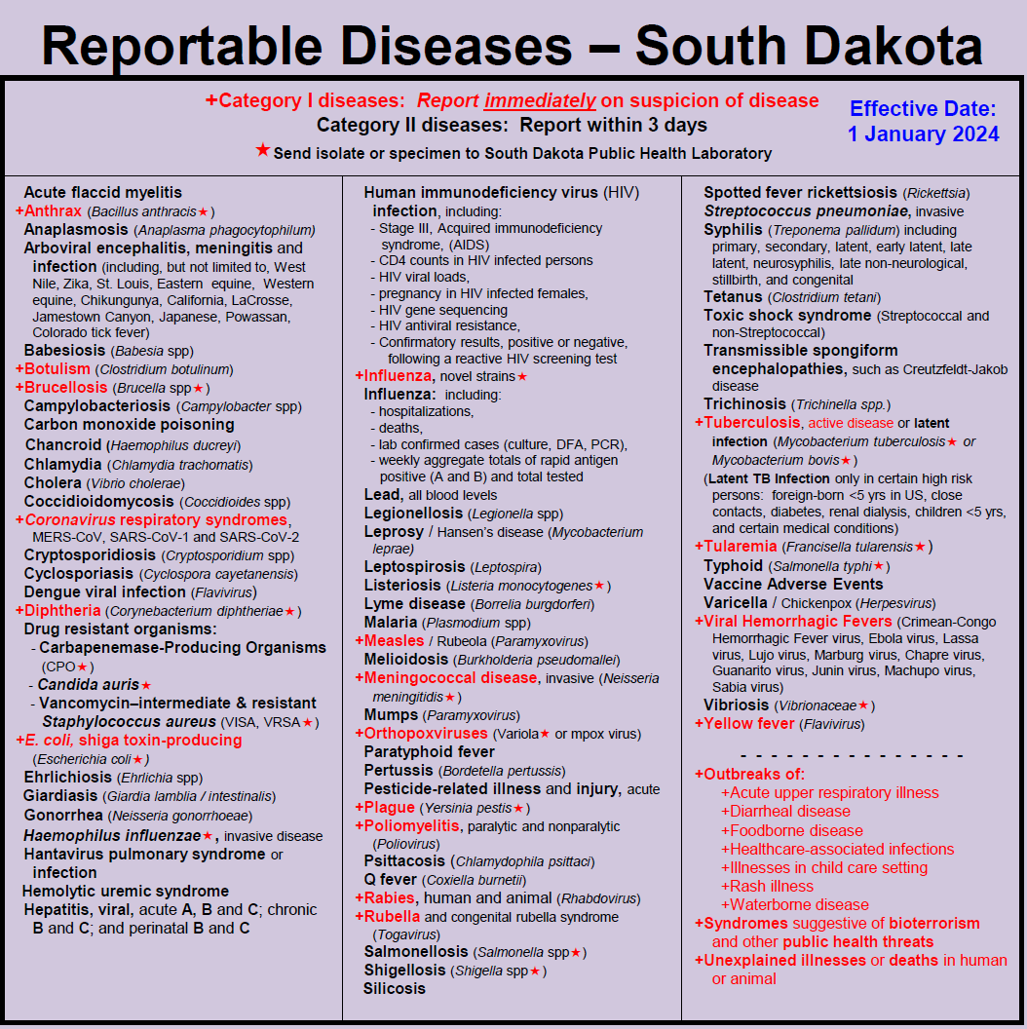
Updated Reportable Disease List
Added
Acute flaccid myelitis
Melioidosis
Expanded
Carbapenem-resistant Enterobacterales to include other Carbapenem Producing Organisms
Smallpox expanded to include other Orthopoxviruses, including mpox
Blood Lead to include all results (including negative)
Removed
MRSA
Notes:
Acin
KPC (6 in 2022 and 3 in 2023) and IMP (5 in 2022 and 1 in 2023).
etobacter – Pseudo
Burkholderia pseudomallieie

Slide 32
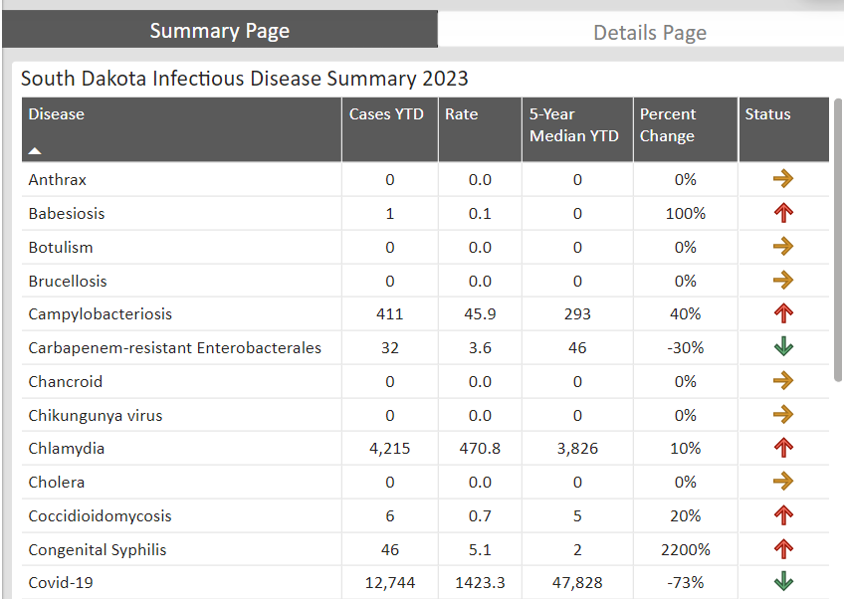
Where you can find our data!
Monthly infectious disease dashboard
Influenza activity dashboard
Coronavirus and Other Respiratory Disease (CORVD) dashboard
Kindergarten and 6th Grade Vaccine Coverage dashboard
Infant mortality dashboard
West Nile Virus dashboard
Suicide dashboard
Overdose dashboard

Slide 33
Thank you
Angela Cascio
Infectious Disease Director
South Dakota Department of Health
605-773-4900
Angela.Cascio@state.sd.us

